Slide 1
Research status on DNN accelerator
Kenshu Seto

Slide 2
Summary of the project (As of April 10, 2018)
Problem
Many accelerator exists, but mostly based on fixed hardware templates
DNN models changing, so fixed hardware template may be suboptimal
Need to provide a efficient framework which generates the best DNN accelerator for ever-changing DNN models
Solution
Given a DNN model, generate HLS and optimizer friendly C code
C code more flexible than RTL code
With the code, explore design space and generate the best one
Key techniques
gem5-Aladdin
System level performance estimation of accelerators with caches/scratchpads
Explore DNN design space which have not been explored yet
Memory optimizations
Memory accesses are bottleneck in DNN but maybe not explored enough yet
Apply (extended) memory access optimizations to DNN

Slide 3
Plan (As of April 10, 2018)
Get HLS-synthesizable C code for DNN
At first, simple one is better to proceed
Define a target system architecture
List up and survey of most relevant DNN accel. work
State-of-the-art system architectures, DSE
State-of-the-art optimizations
Research
System level Design Space Exploration of DNN C code with gem5-Aladdin
Further effective optimization of DNN C code for HLS
Ideas from Post-quantum cryptography (Hamid)
Ideas from memory access optimizations for HLS
Automate them if possible

Slide 4
Outline
Brief introduction on CNN
Most relevant related work
Optimizing FPGA-based Accelerator Design for Deep Conv. Neural Networks, C. Zhang et al., (FPGA 2015)
Fused-Layer CNN Accelerator, M. Alwani et al., (MICRO 2015)
Exploring Hetero. Algorithms for Accelerating Deep Conv. Neural Networks on FPGAs. Xiao et al.,(DAC 2017)
Ongoing work on DNN accelerator

Slide 5
Brief introduction on Convolutional Neural Networks (CNNs)
Source:
Tutorial slides from “Hardware Architectures for Deep Neural Networks”, ISCA 2017
“Efficient Processing of Deep Neural Networks: A Tutorial and Survey,” V. Sze et al., Proceedings of the IEEE, 2017

Slide 6
Convolutional Neural Networks (CNNs)
CNNs used in various image recognitions tasks.
CNNs composed of simple layers
{Convolution, Activation, Pooling, Padding, etc. }
Convolutions accounts for more than 90% of overall computation

Slide 13
CONV Layer C Reference implementation
Can be a starting point for a template C code for HLS
Opportunity for loop optimization
(assume N=1 in this work)

Slide 14
Pooling (POOL) Layer
Down-sampling images

Slide 15
POOL Layer C Reference implementation
Simple C code
R, S: pooling window size
U : stride

Slide 16
Example CNN (VGG16, 2014)
Consists of only CONV and Pooling layers
Fully connected (FC) layer (currently, out of scope)

Slide 17
Optimizing FPGA-based Accelerator Design for Deep Convolutional Neural Networks C. Zhang et al., (FPGA 2015)
Notes:
This MICRO paper reduces the off-chip RAM access by placing the intermediate data between CNN layers on on-chip memory.

Slide 24
Problem: Many off-chip data-transfers
between layers

Slide 26
Fused-Layer CNN Accelerators M. Alwani et al., (MICRO 2015)
Notes:
This MICRO paper reduces the off-chip RAM access by placing the intermediate data between CNN layers on on-chip memory.

Slide 27
Data transfers in VGG19
Lots of transfers between early layers
Leading to high energy consumption
(note: VGG19 is a bit old. May exhibit different tendency in Recent DNN)

Slide 28
Off-chip transfers are energy consuming
Previous work use off-chip memory to store all data
Motivation: Store data in on-chip memory to reduce energy
Many data transfer
between early layers
Many weights transfer
In later layers

Slide 29
Main idea: Pyramid
channel
output pixel depends on a set of tile-shaped data from previous layers
like a pyramid
Store all intermediate data in on-chip RAMs instead of off-chip RAMs
Reuse on-chip data to reduce data-transfer
Pyramid base
Pyramid top
Notes:
In order to generate an output pixel 1, tile-shape of pixels in the preceding layers over channels are used. So, the required data to compute an output pixel become a pyramid-like shape. When next output pixel 2 is computed, we don’t need to load whole data of the tile 2, since we can reuse the data in tile 1. So, only the new data for the tile 2 can be loaded from memory.

Slide 30
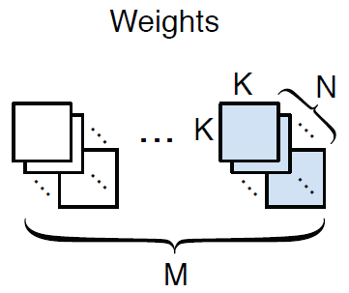
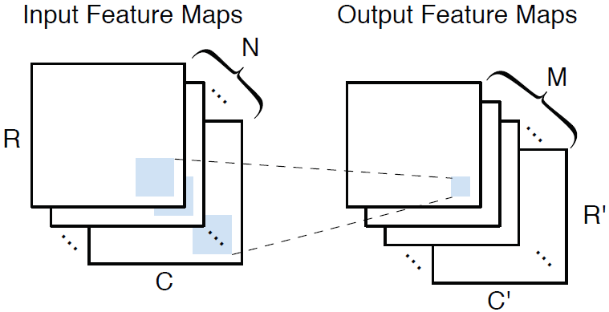
Proposed code for CONV layer
Simple C code
Tile loop for
input/output
channels
loop of
tiled images
loop for kernel
output channel loop (tiled)
input channel loop (tiled)

Slide 31
Design Space Exploration of a CONV layer
Resource and cycles estimated from C code
Tile size T_{m} and T_{n} of output/input channels
Area constraint
=
=
Cycle counts
T_{c}
T_{r}
Assumption
Unrolled
loop body
takes 1 cycle

Slide 32
Task level pipelining
Each layer is a pipe stage
Layers connected by double buffers
Pipeline initiation interval(II) equals to max stage time
Minimize II by changing T_{m} and T_{n}
Latency-minimized solution found by exhaustive search
# pyramids
(64*64
for example)
II
Stage time
Total latency

Slide 33
Implementation of Task-level pipelining
Iterations in output pixels
(Pyramid top points)
Put “#pragma HLS dataflow”

Slide 34
Reuse layers
Data are minimally copied between layers
Only new
data are
copied
Only new
data are
computed

Slide 35
FPGA Evaluation with Vivado HLS
Compare Fused-layer and Previous design for VGG19
The same number of DSP resources between the two
Fused-layer fused first 5 CONV layers in VGG19
Previous design iteratively execute each layer
All data stored in off-chip memory
DRAM bandwidth
significantly
reduced
rougly
the same

Slide 36
Note on MICRO2015 paper
Pioneering work on fused CNN accelerator
Task level pipelining
Executes a set of sequential loops in parallel
Has similar effects as loop fusion
Large buffer size (memory overhead)
Large pyramid base size when many layers fused
Layers connected with double buffer

Slide 37
Exploring Heterogeneous Algorithms for Accelerating Deep Convolutional Neural Networks on FPGAs. Xiao et al., (DAC 2017)
Notes:
This is an paper that proposes the use of line buffers between fused layers.
This paper also proposes method to generate optimal fused architecture (where to fuse, including where
To use Winograd) under resource constraints in FPGAs.

Slide 38
Winograd algorithm for CONV layer
Reduces DSP (multiplier) units by ¼
Uses more complex algorithm
Requires 4x higher bandwidth
Utilize Winograd algorithm in fused CNNs
“Evaluating Fast Algorithms for Convolutional Neural Networks on FPGAs,”, FCCM 2017

Slide 39
Framework overview
Commonly observed framework...
Parametrized
library
Design
point
DNN spec.
Design Space
Exploration
Vivado
HLS
fusion architecture
Line buffer type
Previous type
#Block RAMs,
#DSP units
Off-chip bandwidth,

Slide 40
Proposed Design Space Exploration
Objective
Minimize latency of total execution
Under Resource R and data-transfer T constraints
For each layer, determine
Fusion group (layers in the same group are fused)
reduce I/O bandwidth but increase on-chip RAM size
Different groups execute exclusively and share resources
CONV algorithm type: Conventional or Winograd
Parallelism
Loop unroll factor, or # of data-path lanes
Solved by dynamic programming and branch-and-bound

Slide 41
C code generation for HLS with templates
After design space exploration, optimal C code for HLS is generated with appropriate parameter setting

Slide 42
Another idea: Use line buffer in Pyramid
Use Pyramid in MICRO2015 but without buffer management
Computation reuse between pyramid not described (causes a lot of overhead)
Within Pyramid, line buffers are used (How to do that is unclear)
We can reduce input/output buffers with streaming!
channel x
(ex. conv1)

Slide 43
Result for VGG19 (First 7 layers)
Used Vivado HLS
Transfer constraint
2MB
All layers fused
34MB
All data can be stored in off-chip
More chance to use Winograd
With Winograd, higher performance achieved
Previous work [1]: MICRO2015 paper

Slide 44
Note on DAC2017 paper
Used Winograd algorithm in fused CNN
Improved performance with area-efficient CONV
Extended MICRO2015 with line buffers in pyramids
Detail not described
Requires large I/O buffers in each layer
We can reduce the I/O buffers with streaming interface

Slide 45
Ongoing work on DNN accelerator

Slide 46
Streaming-based DNN accelerator for reducing on-chip memory
CNN powerful for image recognition tasks.
Various CNN accelerators have been proposed.
Fused CNN accelerator is an effective CNN accelerator architecture to reduce off-chip RAM accesses
Although fused CNN accelerator reduces off-chip RAM accesses, large size of on-chip RAMs are required
In this work, we propose a method to reduce on-chip RAM size with compiler transformations that enable streaming interface

Slide 47
General DNN accelerator tool
Given DNN descriptions, quickly generate efficient DNN accelerators satisfying constraints
Design Space
Explorer
Programmable
DNN accelerator
RTL,
code
DNN
Application
Development
Environment
(TensorFlow, Keras, …)
Program for
DNN accelerator
DNN
Description
(Ideal)
DNN accelerator implementation
tool
HLS
code
RTL of
DNN
ASIC,
FPGA
HLS
Target &
resource &
constraints
description
Compiler backend
Code for
GPU,
CPU,
distributed
computing
Target
scope
Parametrized
code/architectural
template

Slide 48
Overall picture (more focused)
Design Space Exploration
(Analytical model)
C code genarator
Optimized
DNN
C code
FPGA
ASIC
DNN
Description
HLS
RTL of
DNN
Target &
resource &
constraints
description
Optimized
C templates
conv, pool…
C code used
as intermediate
language
Action items
Define DNN description (subset)
Develop C templates (and optimize it)
Develop C code generator for DNN C code
Develop DSE

Slide 49
What have been done so far (1/2)
Made reference C programs for DNN
Applied loop fusion and scalar replacement to two Conv layers
Large changes in loop size prevent fusing all loops in DNN
Literature in-depth survey (applying loop fusion in mind)
Literatures
Efficient Processing of Deep Neural Networks: A Tutorial and Survey, V. Sze et al., Proceedings of the IEEE, 2017
Found work on Fused CNN accelerator
Fused-Layer CNN Accelerators, M. Alwani et al., MICRO 2015
Exploring Heterogeneous Algorithms for Accelerating Deep Convolutional Neural Networks on FPGAs. Xiao et al., DAC 2017
Found
Task-level pipelining useful for parallel execution of layers
Room for improvement in memory size reduction

Slide 50
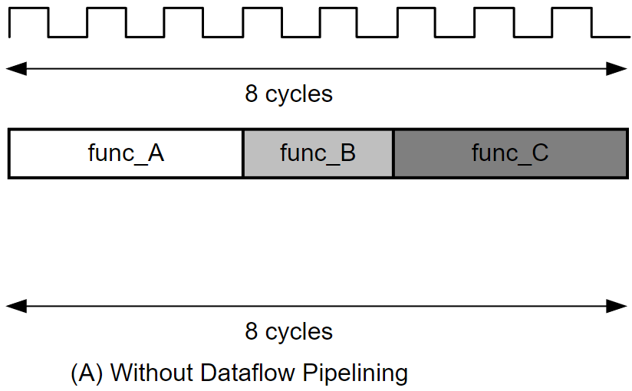
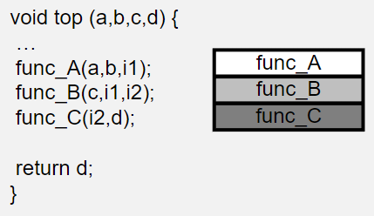
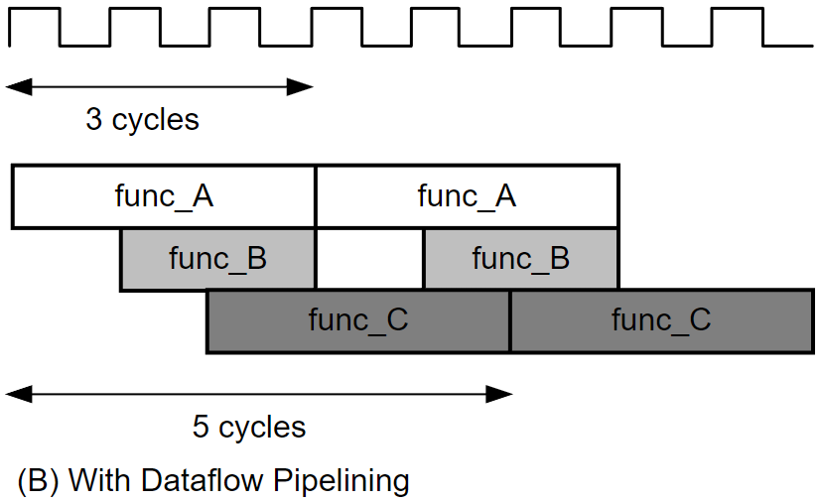
Speedup by Task-level pipelining
Execute next layers as soon as input data are produced
#pragma HLS dataflow
func_A, B, C represents
Nested loops for CNN layers

Slide 51
What have been done so far (2/2)
Take a brief look at DNN designs from Xilinx
Uses stream interface
Unfortunately, only for binary NN and Quantized NN with1 bit weights, 2 bit activations
https://github.com/Xilinx/BNN-PYNQ
https://github.com/Xilinx/QNN-MO-PYNQ
Investigate Vivado HLS with a simple example
Usage, restriction on HLS DATAFLOW, hls::stream interface, ARRAY_PARTITION
Find tricky things (handling of weights)
Optimized reference DNN programs to use stream interface for parallelization
Successful for first two layers (will be successful for other layers, too)

Slide 52
For efficient stream execution
Input/output of DNN layers: 3D images
Want to arrange loops of all layers so that
Outputs are generated in the same order of inputs
Reduce “wait” and buffer size
A loop nest of DNN
Layer
Input
Feature
map
①
②
③
④
⑤
⑥
⑦
⑧
Output
Feature
map
①
②
③
④
⑤
⑥
⑦
⑧

Slide 53
Optimized C template
Applied loop interchange , unrolling, fusion, etc.
void Conv2D_1(int I[3][16][16], DATA_T W[8][3][3][3], int B[8], hls::stream<int> &O_strm) {
int m, x, y, i, j, k;
int ifm, ofm;
int I_0, I_1, I_2, I_3, I_4, I_5, I_6, I_7, I_8;
for (x=0; x<16; x++) {
for (y=0; y<16; y++) {
for (k=0; k<3; k++) {
I_0 = I[k][x+0][y+0];
I_1 = I[k][x+0][y+1];
...
I_8 = I[k][x+2][y+2];
for (m=0; m<8; m++) {
if (k==0) ofm = B[m];
else ofm = O_buf[m];
if (x < 16 && y < 16) ifm = I_0;
else ifm = 0; // zero padding
ofm = ofm + ifm * W[m][k][0][0];
if (x < 16 && y+1 < 16) ifm = I_1;
else ifm = 0; // zero padding
ofm = ofm + ifm * W[m][k][0][1];
...
if (k<2) O_buf[m] = ofm;
else if (k==2) O_strm.write(ofm);
} } } } }
void Conv2D_1(int I[8][16][16], int W[8][8][3][3], int B[8], DATA_T O[8][16][16] {
int m, x, y, i, j, k;
int ifm, ofm;
for (m=0; m<8; m++) {
for (x=0; x<16; x++) {
for (y=0; y<16; y++) {
ofm = B[m];
for (k=0; k<8; k++) {
for (i=0; i<3; i++) {
for (j=0; j<3; j++) {
if (x+i < 16 && y+j < 16) {
ifm = I[k][x+i][y+j];
} else {
ifm = 0; // zero padding
}
ofm = ofm + ifm * W[m][k][i][j];
}
}
}
if (ofm < 0) { // relu activation
ofm = 0;
}
O[m][x][y] = ofm; } } } }

Slide 54
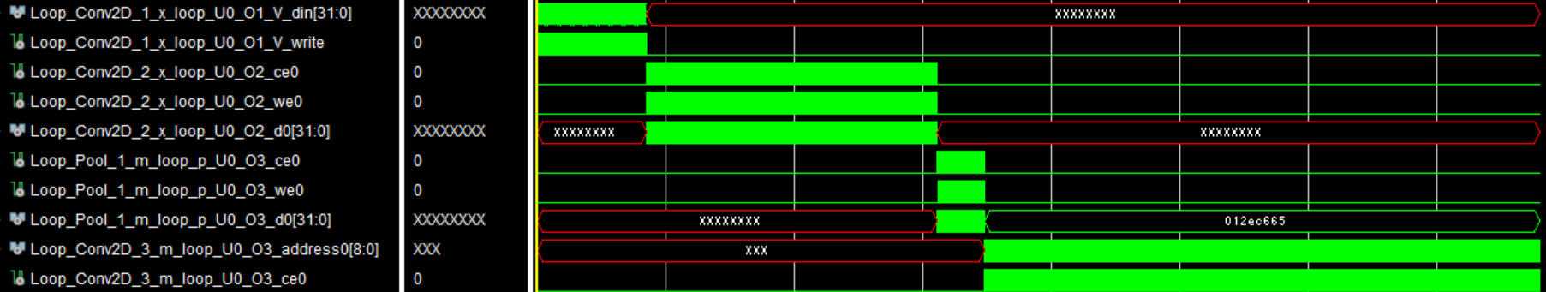
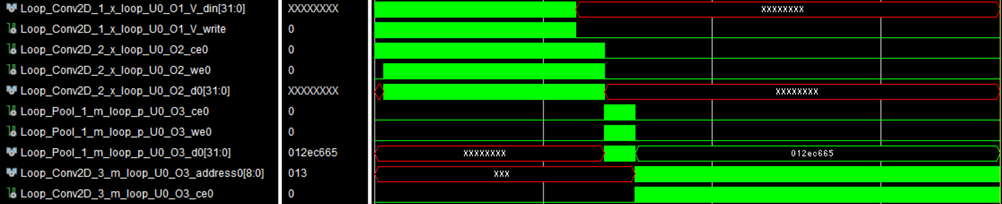
Simulation of Optimized C template
By optimization, two layers are executed in parallel
Before optimization
After streaming optimization

Slide 55
C code generator and format for DNN description
Excel file describing, ex, VGG19
Layer # | Layer Type | Name | M | C | H | W | R | S | E | F | U | Padding | Activation | bias | M | F | E | R | S | U | Padding | Pooling Type
1 | Conv2D | block1_conv1 | 64 | 3 | 224 | 224 | 3 | 3 | 224 | 224 | 1 | same | relu | Yes
2 | Conv2D | block1_conv2 | 64 | 3 | 224 | 224 | 3 | 3 | 224 | 224 | 1 | same | relu | Yes
3 | MaxPooling2D | block1_pool |  |  |  |  |  |  |  |  |  |  |  |  | 64 | 112 | 112 | 2 | 2 | 2 | No | Max
4
5
6
Or, Text file (Json file, xml file, anything) for VGG19
LayerNo=1, LayerName=block1_conv1, LayerType=Conv2D, M=64, C=3, H=224, …,
LayerNo=2, In1=1, LayerName=block1_conv2, LayerType=Conv2D, M=64, C=3, H=224, …,
LayerNo=3, In1=2, LayerName=block1_pool, LayerType=MaxPooling2D, M=…
C code
generator
Can be used for many research on DNN accelerators
C program for
VGG19
accelerator
C program for
VGG19
Test bench

Slide 56
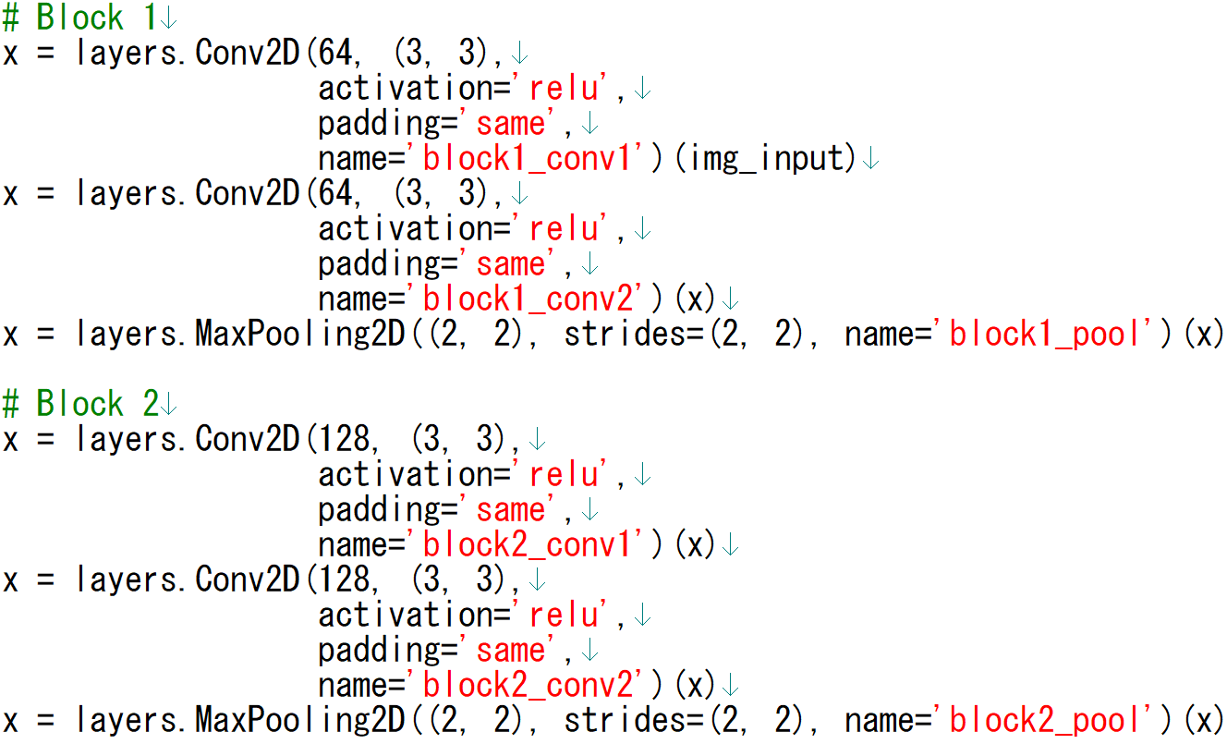
Example Keras description (VGG19)
Extract DNN description for C code generation from Keras

Slide 57
Other DNNs in Keras
To handle them, following layers must be supported for code generator
Shortcut, branch not supported by Vivado HLS DATAFLOW
Network | Layers, constructs to be supported
ResNet50 | add layer, shortcut construct
densenet | concatenate layer
Mobilenet | DepthwiseConv2D layer
Inception v3 | concatenate layer, branch construct
Xception | SeparableConv2D layer

Slide 58
ResNet50 (popular DNN with 50 layers)
Workaround necessary to handle “Shortcut”
Shortcut

Slide 59
Action items (1/2)
C code generation (Jiyoung, Sujin)
Keras (Python) to DNN description (text format or Excel file)
VGG19, ResNet50, (Inception v3, densenet, …)
DNN C code generation from DNN description
Verification of DNN C code (Hamid)
It is necessary to verify the equivalence between Keras and C
Need to incorporate batch normalization layers into Conv layers
Need to output weights and intermediate images
Optimized C template (Kenshu)
Pooling, activation with streaming
Define DNN description format for more complex DNN
That can handle merge and branch in ResNet, Inception

Slide 60
Action items (2/2)
Implementation of previous work for comparison
MICRO 2015 or DAC2017 (detail unclear)
Experimental Evaluation with Vivado HLS
BRAMs, Logic element, execution cycles
Issue: In ASICs, minimizing on-chip RAM usage is very useful, but for FPGA, it is O.K if constraints on BRAM is satisfied
Comparison against MICRO 2015 or DAC 2017
FPGA board necessary for C-RTL co-simulation
Software RTL simulation extremely slow
FPGA board should be large enough to execute whole DNNs
Design Space Explorations (Tile size, unroll factor)
Analytical model?
Unfortunately, we cannot use gem5-Aladdin for task-level pipelined C code …
More survey on related works to put in the publication

Slide 61
Supplementary slides

Slide 62
Research project at DRG: Design space exploration and memory access optimization for Deep Neural Network (DNN)

Slide 63
Research plan
Develop template C code
Easier for loop optimization (fusion) and memory optimization
Conv (different strides with Activation), Pooling
Develop a generator tool
that generate C code from DNN descriptions
Keras can be used as DNN descriptions
Optimize the generated C code manually or semi-automatically
Loop fusion, interchange, tiling, …
Buffer optimization
Run gem5-Aladdin for estimation
only for single thread code
Synthesize with Vivado-HLS
Use #pragma HLS DATAFLOW to do task level pipelining
Implement the previous work (DAC2017, MICRO 2015) and compare the results (resource, #cycles, etc)

Slide 64
Summary of the project
Problem
Many accelerator exists, but mostly based on fixed hardware templates
DNN models changing, so fixed hardware template may be suboptimal
Need to provide a efficient framework which generates the best DNN accelerator for ever-changing DNN models
Solution
Given a DNN model, generate HLS and optimizer friendly C code
With the code, explore design space and generate the best one
Key techniques
gem5-Aladdin
System level performance estimation of accelerators with caches/scratchpads
Explore DNN design space which have not been explored yet
Memory optimizations
Memory accesses are bottleneck in DNN but maybe not explored enough yet
Apply (extended) memory access optimizations to DNN

Slide 65
Plan (As of April 10, 2018)
Get HLS-synthesizable C code for DNN
At first, simple one is better to proceed
Define a target system architecture
List up and survey of most relevant DNN accel. work
State-of-the-art system architectures, DSE
State-of-the-art optimizations
Research
System level Design Space Exploration of DNN C code with gem5-Aladdin
Further effective optimization of DNN C code for HLS
Ideas from Post-quantum cryptography (Hamid)
Ideas from memory access optimizations for HLS
Automate them if possible

Slide 66
Get HLS-synthesizable C code for DNN
Possible candidates
TensorFlow, Caffe
Strength: Complete framework used by many organizations
Weakness: may not be easy to rewrite the C++ into HLS-aware C
YOLO
Strength: Complex application (image detection) written in C
Weakness: may not be easy to rewrite the code into HLS-aware C
GUINESS
Strength: Generates HLS-friendly simple C code, easy to modify
Weakness: Simple network (good starting point), binarized only
Provides both learning and inference
Network with conv layer (binalized), pooling layer supported

Slide 67
Basic Element of Neural Networks
Neuron
Multiply and Addition
Simple Non-linear element
f
Notes:
In neurons, each input x0, x1, … are multiplied by weights w0, w1, … and are summed up. So, in neural networks, a neuron basically does multiplication and addition. The results of the summation go through non-linear unit f and becomes the output of the neuron. Several non-linear activation functions exist, but Rectified Linear Unit (ReLU) is one of the most used activation functions, and it’s very simple. In this way, a neuron accepts inputs and generates an output value.

Slide 68
Basic (and abstract) Neural Network
Neurons are connected layer-by-layer.
Weights are computed by training with large data set.
Using neural network for classification is called inference.
w₀
w₁
Ex.
Input
image
Classification/
prediction
Results
(Cat, Dog, …)
Pixel
value
(More than one hidden layers)
Notes:
Each neuron explained in the previous slide are connected layer-by-layer. More specifically, the output value of a neuron becomes an input value of the other neuron in the next layer

Slide 69
Fully connected layer
DNN usually fully connected layer at the last stages
Weights contains many zeros, leading to sparse matrix multiply
Fully-connected and Sparsely-connected shows different characteristics
Ex. Convolutional
layer

Slide 70
Experiments
VGGNet-E (VGG19)
fuse the following layers
first 5 conv + 2 pooling (DAC 2017, MICRO 2015)
Conv layers include ReLU and padding
(Probably, because of lack of resources, stop by 5 conv layers)
AlexNet
fuse the following layers
5 conv + 3 pooling (DAC 2017)
2 conv + 2 pooling (MICRO 2015)
neglecting normalization phase (incorporated in weights)

Slide 71
Background
Utilizing Winograd algorithm
Peak performance by the available hardware
Because of lack of bandwidth
Peak performance by the off-chip bandwidth

Slide 72
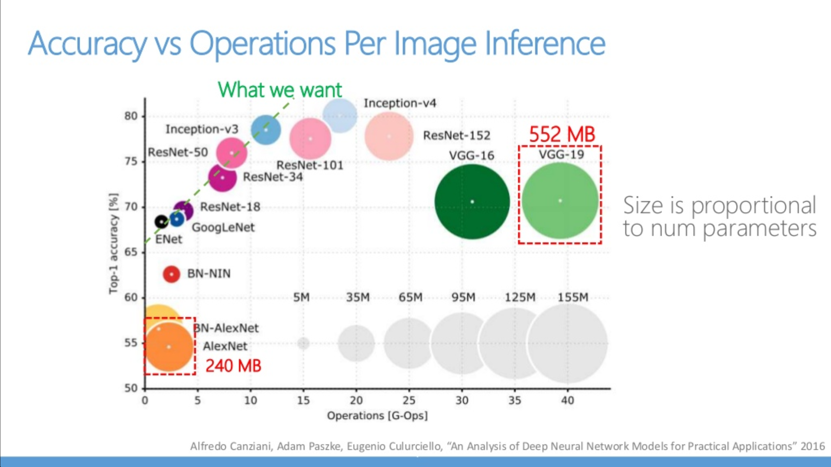

Slide 73
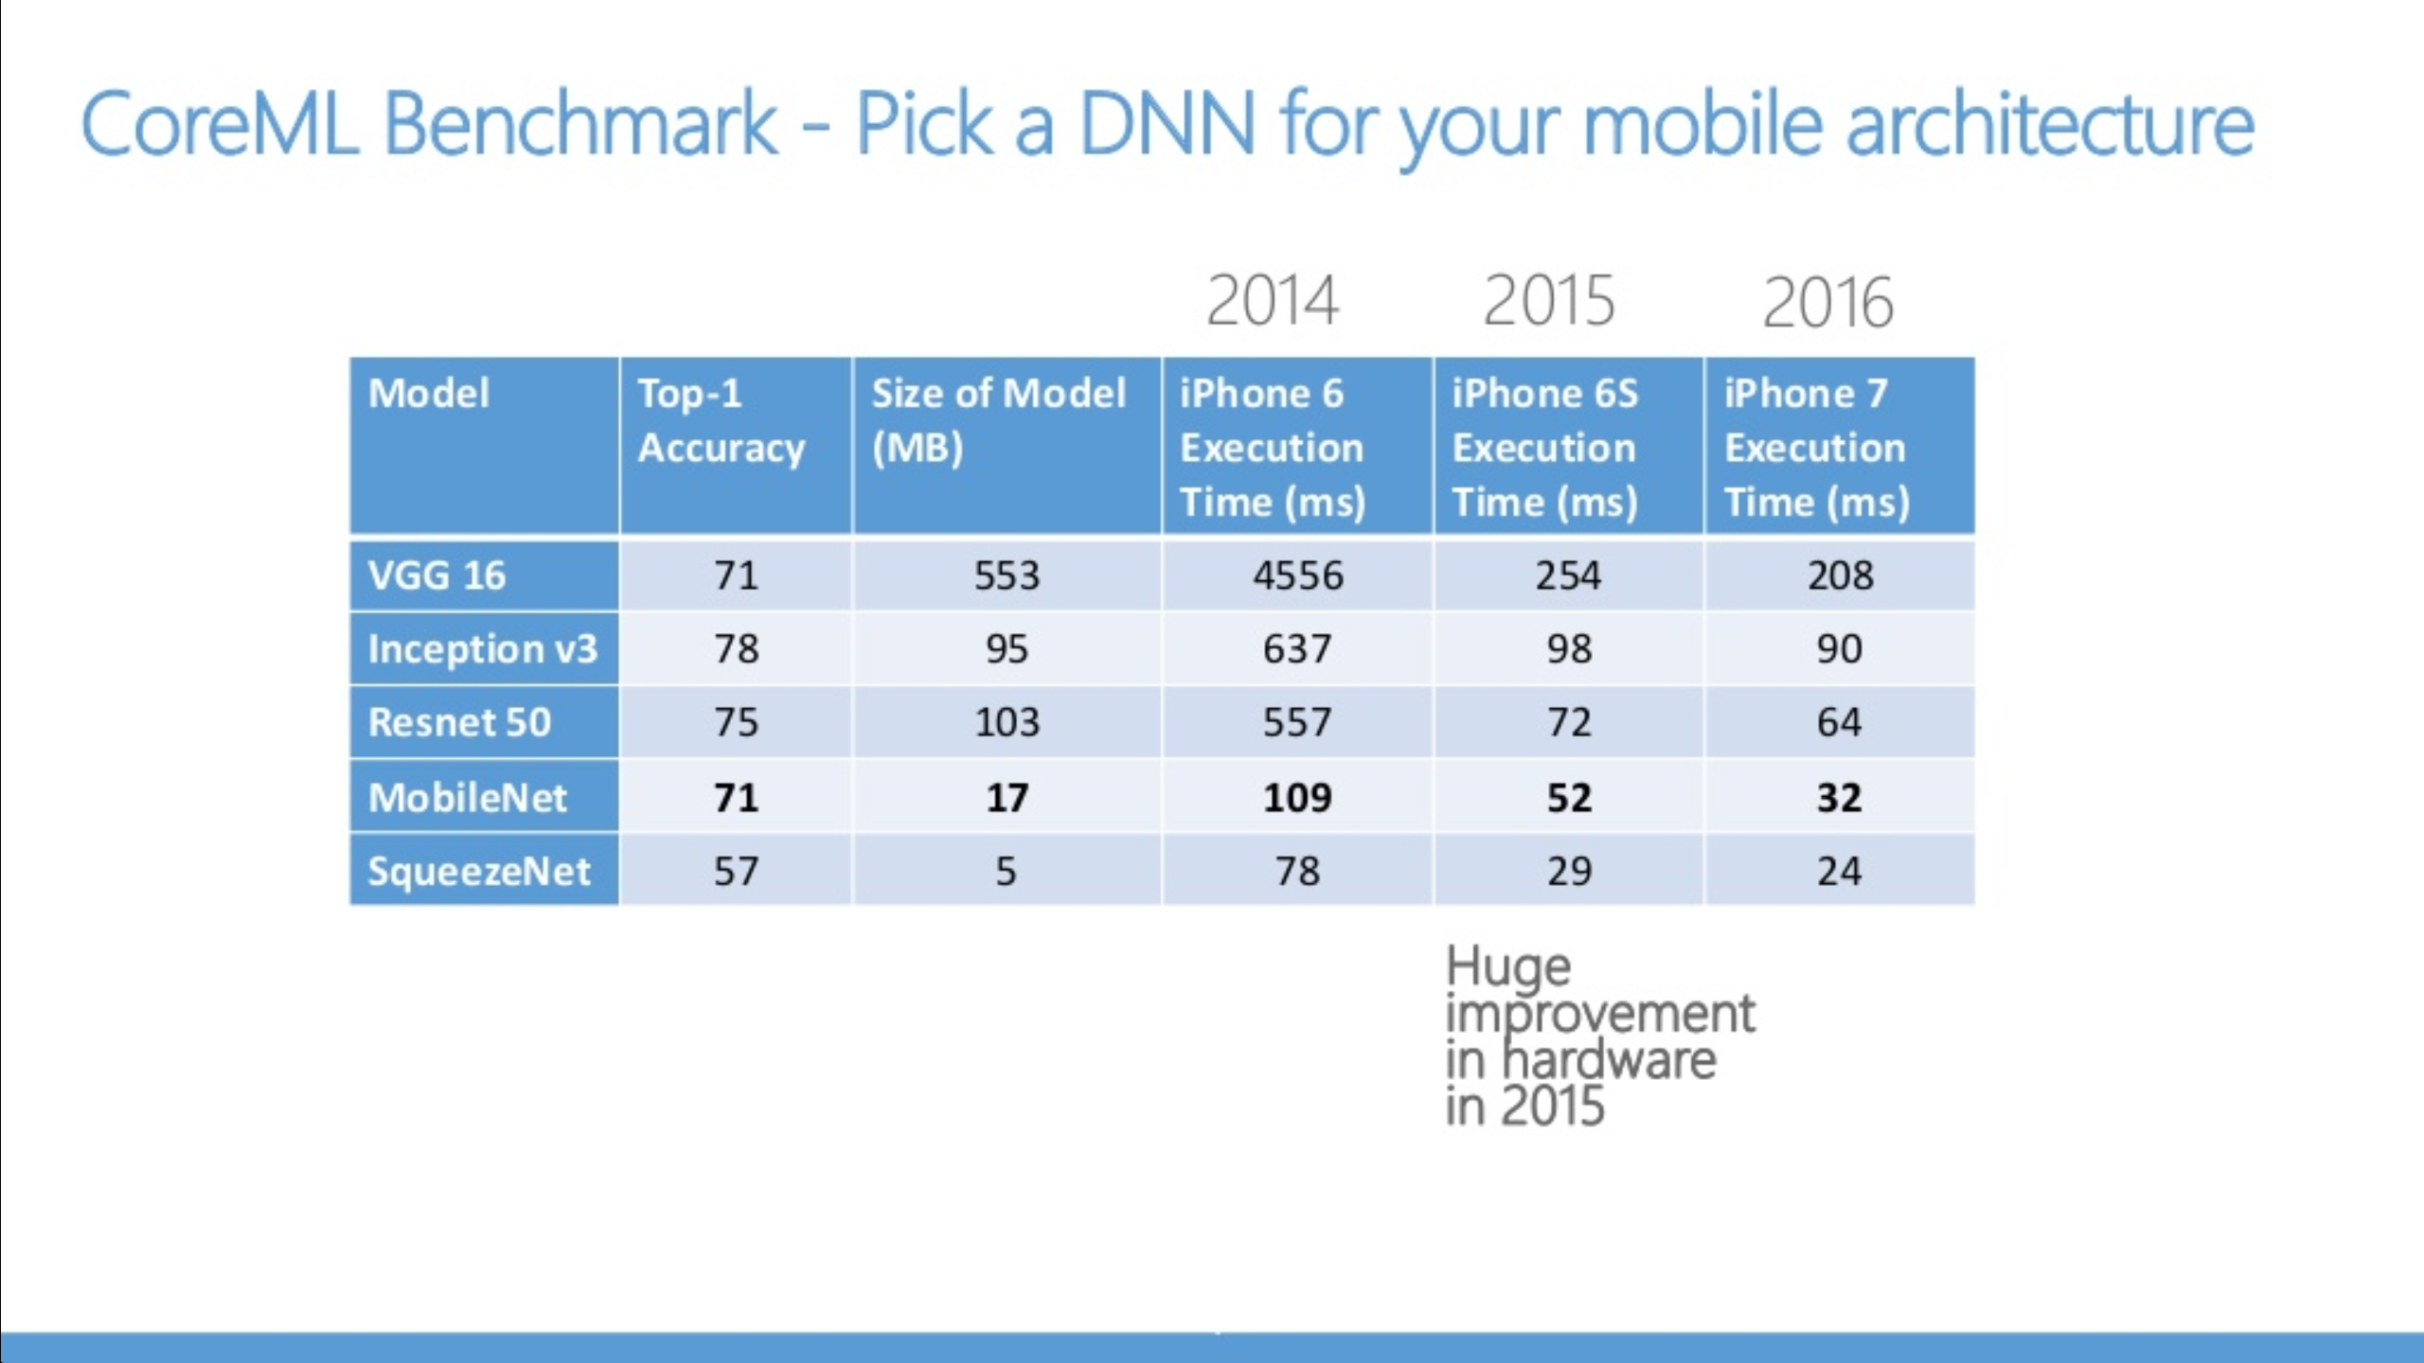

Slide 74
Weights in DNN are usually pruned
60-70% reduction in Conv layers, 90% reduction in FC layers
Sparse weights corresponds to sparse matrix multiplication
Weights are not always sparse, and sparse

Slide 75
Tensor Comprehension

Slide 76
Related work

Slide 77
Recent research on CNN accelerators

Slide 78
Summary

Slide 80
Convolution (CONVL) Layer computation (1 layer)
For each output pixel, do the following computation

Slide 82
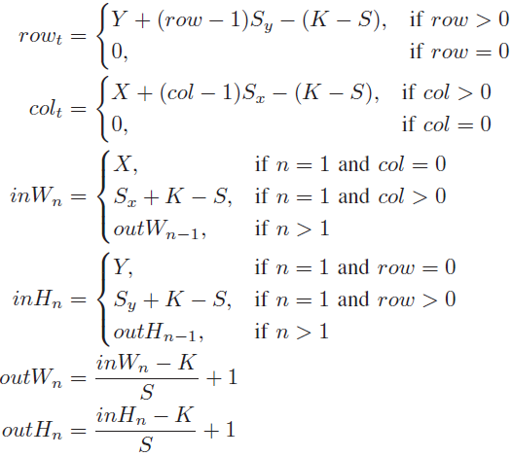
Symbols used in the implementation code
Elaborately developed to maximize reuse
row, col:
Coordinate of
Pyramid top
S_{x}, S_{y}:
stride of the adjacent
pyramid base

Slide 83
Result for AlexNet (5 CONV + 3 Pool)
All layers fused
Compared to MICRO2015, 1.24X speedup
DSPs saved by Winograd algorithm are utilized by conventional CONV layers to enhance performance

